Slide 1
The cold region
Group 17

Slide 2
OUTLINE
Introduction of the cold regions and examples
Characteristics of the cold region
Importance of studying the cold region
Examples of organisms
Adaptation of organism to the cold region
Environmental challenge
Conservation
Conclusion

Slide 3
A cold region refers to a geographical area characterized by low temperatures and challenging environmental conditions. These regions are typically located near the Earth's poles, including the Arctic in the northern hemisphere and the Antarctic in the southern hemisphere. Also, other examples include Tundra, Alpine and Mountainous , and Subarctic region.
The Arctic region encompasses the area around the North Pole and extends into parts of several countries, including Canada, Russia, Greenland (an autonomous territory of Denmark), Norway, the United States (Alaska), and Iceland. It is surrounded by the Arctic Ocean.

Slide 4
The Arctic experiences long, extremely cold winters and relatively short, cool summers. Average temperatures in winter range from -30 to -40 degrees Celsius (-22 to -40 degrees Fahrenheit), while summer temperatures can reach 0 to 10 degrees Celsius (32 to 50 degrees Fahrenheit)
The Arctic is known for its extensive sea ice cover, which forms during winter and melts during summer. It also contains ice caps, glaciers, and permafrost that cover a significant portion of the landmass.

Slide 5
The Antarctic region consists of the continent of Antarctica, which is situated at the southernmost part of the Earth. It is surrounded by the Southern Ocean. Antarctica is governed by the Antarctic Treaty System, with no permanent population.
Antarctica is the coldest place on Earth. Average temperatures in winter can drop below -60 degrees Celsius (-76 degrees Fahrenheit), while summer temperatures hover around -20 degrees Celsius (-4 degrees Fahrenheit) near the coast. It is characterized by strong winds and dry conditions
Antarctica is covered by a massive ice sheet that contains around 90% of the world's ice and about 70% of its freshwater. The ice sheet is several kilometers thick in some areas and plays a significant role in global sea level rise dynamics.

Slide 6
Alpine and Mountainous Regions: High-altitude regions around the world, especially those in temperate and subarctic latitudes, can be classified as cold regions due to their low temperatures and snow cover. Examples include the Alps in Europe, the Rocky Mountains in North America, the Andes in South America, and the Himalayas in Asia.
Tundra Regions: Tundra regions are found primarily in the Arctic and subarctic regions but can also be present at high altitudes in mountainous areas. Examples include the tundra regions of northern Canada, Alaska, Russia's Yamal Peninsula, and parts of Scandinavia.

Slide 7
Characteristics of the cold region
Low Temperatures
Ice and Snow
Permafrost
Harsh Weather Conditions
Biodiversity

Slide 8
Importance of studying cold region
Climate Change
Biodiversity and Ecosystems
Freshwater Resources:

Slide 9
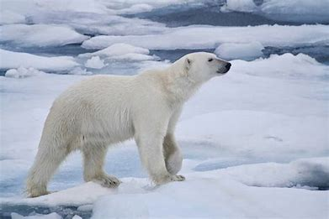
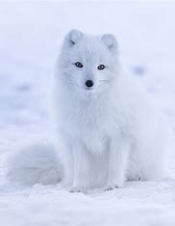
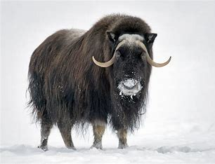
Example of organism in the cold region
polar bear Arctic Fox
Musk Ox

Slide 10
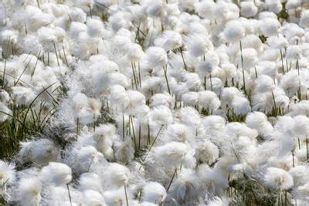
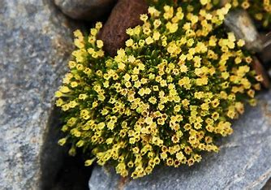
Cotton grass
Arctic plant

Slide 11
Adaptation of organism in the cold region
For plant
Small Size
Hairy or Waxy Surfaces
Short Life Cycles
Deep Root Systems
Freeze Tolerance

Slide 12
For animals
Thick Insulating Fur or Feathers
Large Body Size
Camouflage
Behavioral Adaptations

Slide 13
environmental challenges OF COLD REGION
Climate Change
Melting Ice
Permafrost Degradation
Biodiversity Loss
Resource Extraction

Slide 14
Conservation of cold regions
Arctic Council
Circumpolar Biodiversity Monitoring Program (CBMP)
Protected Areas
Long-Term Ecological Research (LTER) Programs

Slide 15
CONCLUSION
The cold region provides conditions which makes it possible for only few organisms to survive there. This is because they have developed physiological adaptations that make their survival possible.

